Slide 1
financial Fraud detection
ARCHARIOS (URH-5)

Slide 2
Introduction
The Financial Management System is a software that is used to check the authenticity of a particular transaction in a financial company.
Train a ML model to detect fraudulent transactions using simulation set provided
Using insights from the model to create an actionable plan to prevent future fraudulent transactions

Slide 3
initial data exploration
Loaded data
Checked data types of columns
Looked for missing and unique values

Slide 4
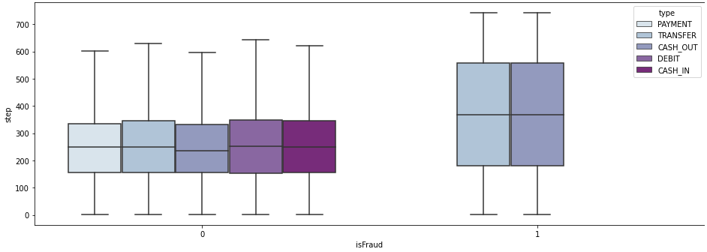
EDA

Slide 5
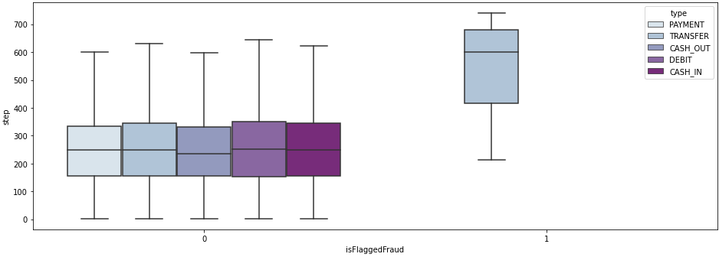
EDA

Slide 6
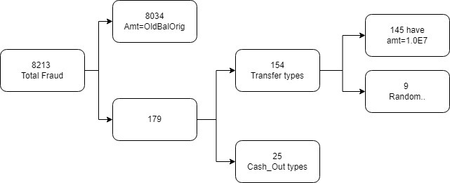
TREND IN FRAUDS

Slide 7
DATA PREPARATION
We decided to use XGBoost’s XGBClassifier.
XGBoost applies a better regularization technique to reduce overfitting, and it is one of the differences from the gradient boosting. The xgboost.XGBClassifier is a scikit-learn API compatible class for classification. We created our machine learning model using XGBClassifier.
XGBoost works best with numeric values.

Slide 8
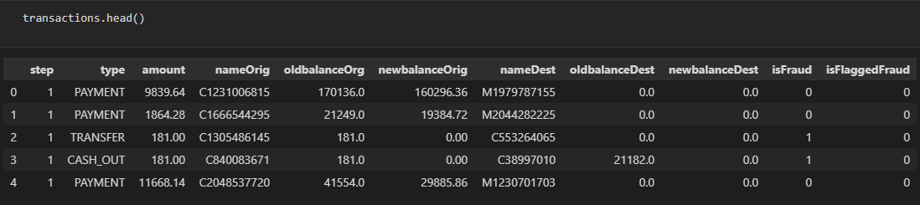
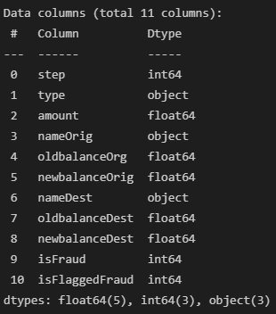


DATA PREPARATION

Slide 9

Data preparation
We observed that the amounts in many of the transactions were not matching with the new balances and old balances of accounts.
Hence we decided to add a flag of our own to the data.

Slide 10
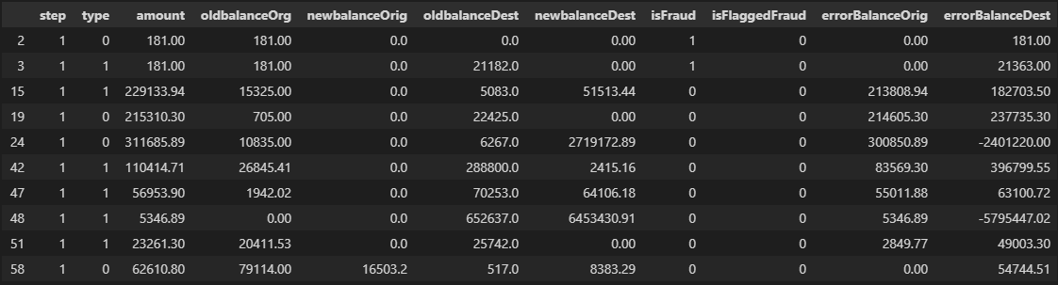
New data

Slide 11
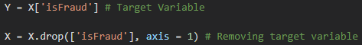
Creating feature/labels
LABEL
FEATURES

Slide 12
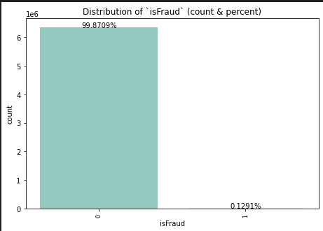
REDUCING BIAS
We used undersampling to reduce the noise and bias of the data and make the ratio more proportional

Slide 13
Splitting data for model
We divided the data such that the training set is 70% of the total data

Slide 14
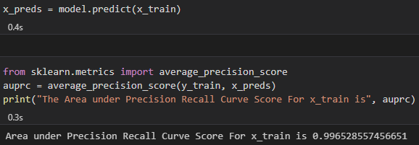
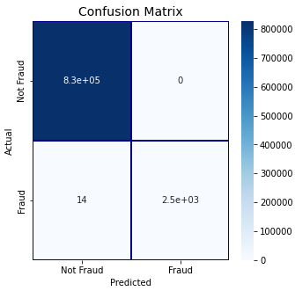
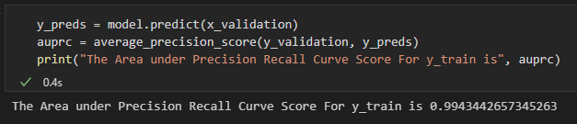
Train and evaluate
We then use the training set to train the model
Then we evaluated the predictions made by the model

